Slide 1

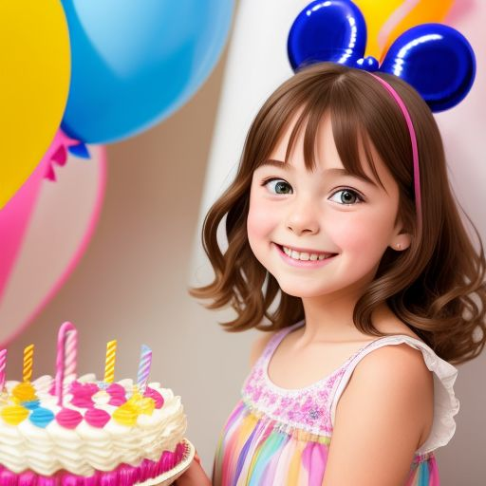

Today’s story is Lily’s Surprise Birthday. Let’s begin!
Lily's Surprise Birthday

Slide 2
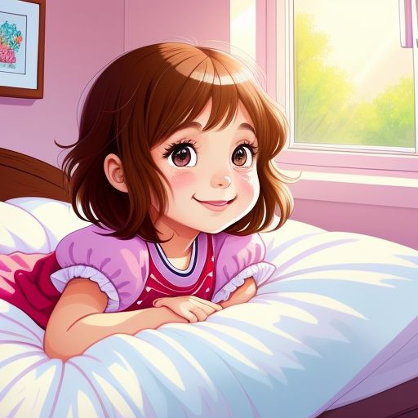
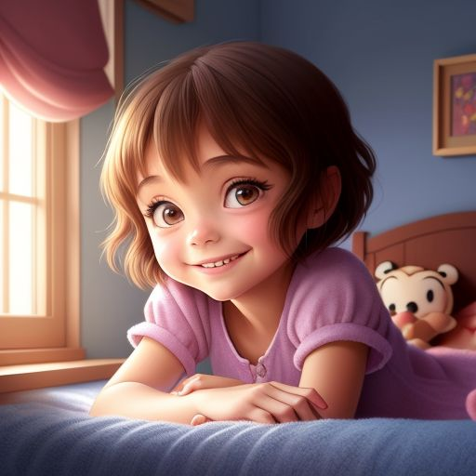
Lily is a little girl. She is six years old. Today is her birthday. She feels happy.

Slide 3
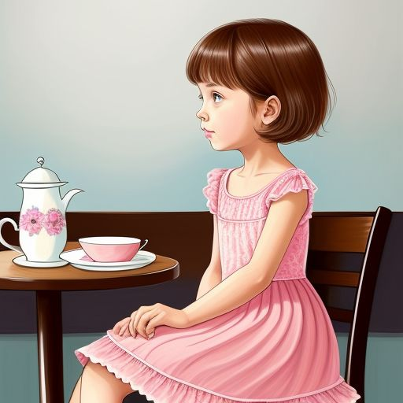
Lily sits at the table. She eats breakfast. There are no balloons. There is no cake. Lily feels sad.

Slide 4
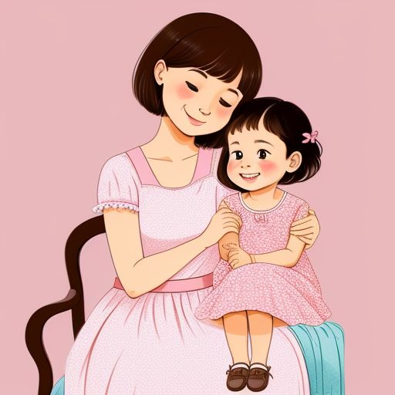
Mom smiles at Lily. She says, ‘Be patient, Lily. It is a surprise!’

Slide 5
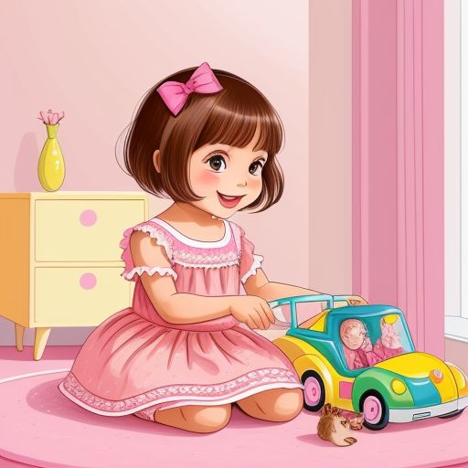
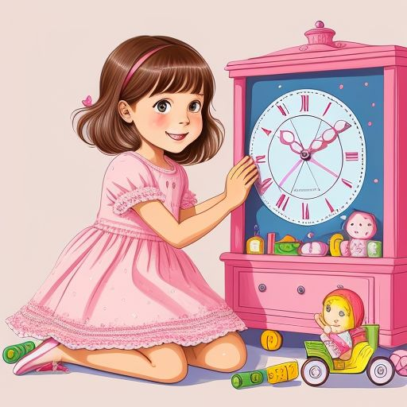
Lily plays with her toys. She waits and waits. She feels curious.

Slide 6
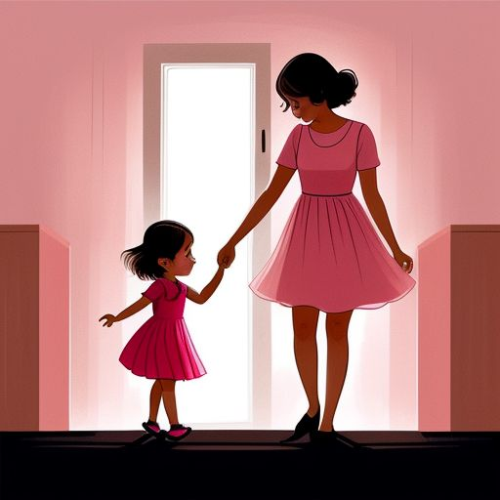
Mom says, ‘Lily, come here!’ Lily walks into the room. It is dark.

Slide 7
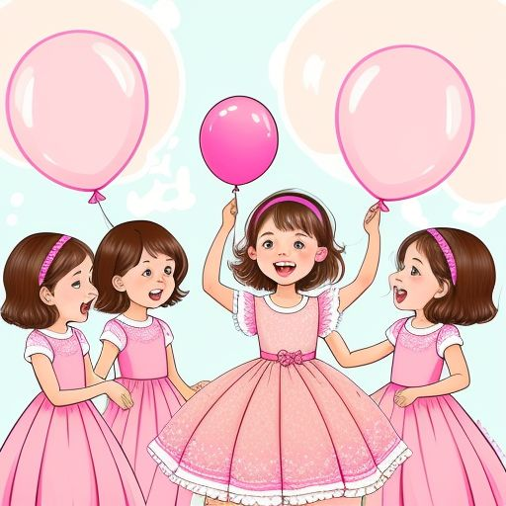
The lights turn on. Balloons and decorations are everywhere. Her friends say, ‘Surprise! Happy Birthday!

Slide 8
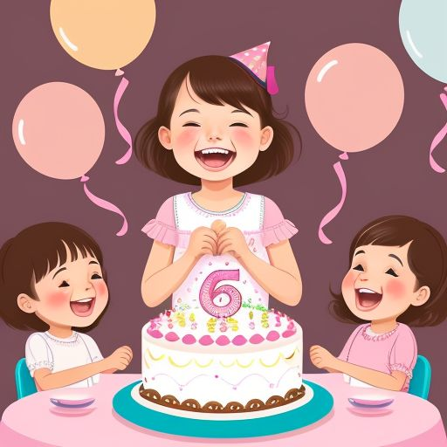
Lily laughs. She feels so happy. There is a big cake on the table. It has six candles.

Slide 9
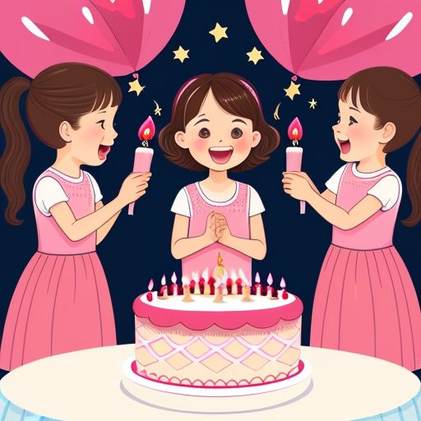
Lily blows out the candles. Her friends clap and cheer. Lily says, ‘Thank you, everyone!

Slide 10

Lily was surprised, and she was very happy. What was the best part of the story?

Slide 11
How old is Lily?
What did Lily’s friends say?
What did Lily blow out?

Slide 12

Thank you for listening! Watch more stories and practice English with us.

